Slide 1
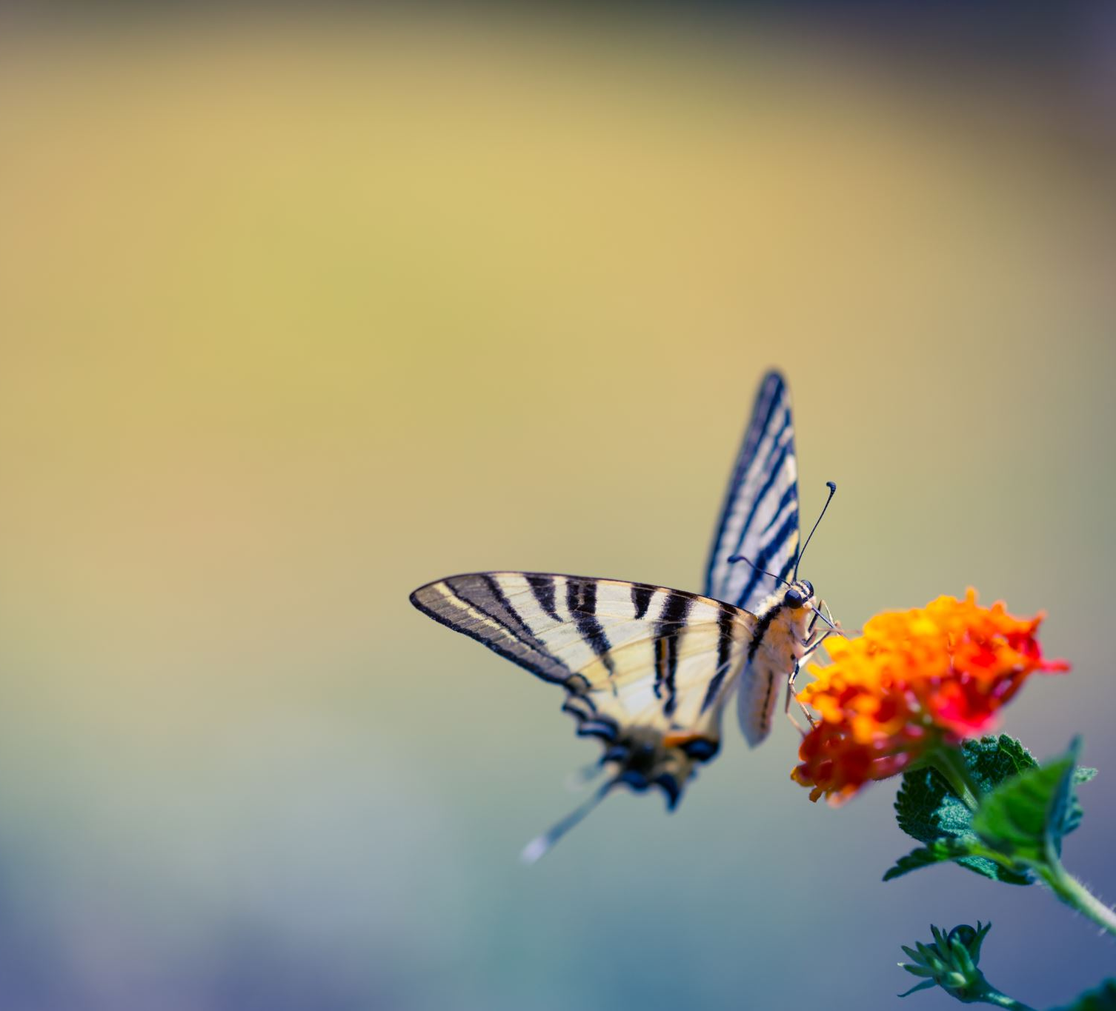
The Whys of Butterflies
Rosli Omar
Sunda Shelves
22 September 2024

Slide 2
Four Whys:
1.Why more species of moths than butterflies?
2.Why so few butterfly families?
3.Where in the world are the most butterfly species found – and why?
4.Why should we bother with butterflies (and moths and other bugs)?
=>
Lesser Cruiser. Vindula dejone. Peronda Kecil

Slide 3
1. Why more species of moths than butterflies?
In Peninsular Malaysia (PM):
~10,000 moth species
1048 butterfly species
i.e. ~10x moth:butterfly species
Global:
160,000 Moth species
19,000 Butterfly species
i.e. ~10x or 90% are moths species
(more flowers bloom at night?)
Search Why via DuckDuckGo, Bing, Google , no answer
=>
Hieroglyphic Flat. Odina hieroglyphica. Datar Indah

Slide 4
..Why more species of moths than butterflies?
i.Evolutionary headstart for moths:
Moths appeared 200 mya. Butterflies evolved from moths 100 mya.
=>
Marbled Map. Cyrestis cocles earli -form earli. Peta Marmar

Slide 5
..Why more species of moths than butterflies?
ii.Moths are nocturnal insects
i.e. no sunlight to warm them up, so smaller ranges i.e. can’t fly far, relative to diurnal butterflies.
Thus, for any given area there are more micro-niches or micro-habitats for moths.
Thus, more species possible for moths.
=>
Marbled Map. Cyrestis cocles earli -f formosa. Peta Marmar

Slide 6
..Why more species of moths than butterflies?
iii.Existence of micro-moths or microlepidoptera
Smaller than typical butterflies, so can’t fly far i.e smaller ranges, thus more micro-habitats,
Thus, more species possible for moths.
=>
Common Mime. Papilio clytia. Ceria Penyamar Biasa

Slide 7
..Why more species of moths than butterflies?
Answers by Copilot:
-More habitats than those for butterflies [2]:
-Caves, dense forests
-”Reproductive strategies. Moths often have more varied reproductive strategies and life cycles, which can lead to higher speciation rates^{3”}
^{-Not trustworthy?}
^{=>}
Callidula sakuni, a day-flying, diurnal moth

Slide 8
2.Why so few butterfly families?
Global: 7 butterfly family (C&P5)
PM: 6 families, 1048 species
Contrast for PM:
-Birds (class): 95 families, 719 species
-Mammals (class): 43 families, 257 species
-Odonata: 17 families, 253 species
-Snakes: 17 families, 163 species
Ratio, species:families:
butterflies 174, birds 8, mammals 6, odonata 15, and snakes 10
=>
Dark (or Black-tipped) Archduke. Lexias dirtea. Bangsawan Gelap

Slide 9
.. Why so few butterfly families?
Family: a group of organisms that come from the same ancestors and share common characteristics. Eg, Dogs, wolves, foxes, members of family, canidae.
Mammals: herbivores, carnivores, omnivores – so, different mouth parts and anatomy. Thus, many families.
Birds: carnivores, insectivores, frugivores, nectarinaes – so different mouth parts, and anatomy. Thus, many families.
Butterflies: only feed on fluids via one mechanism, proboscis. So, no need for different mouth parts and anatomy. Thus, few families.
Moths: same diet as butterflies, but some feed on pollen, some don’t feed at all. Globally, 125 families, 160,000 species.
=>
Atlas Moth, Attacus atlas. Doesn’t feed as adult

Slide 10
.. Why so few butterfly families?
Sent by Copilot:
Butterflies are classified into a relatively small number of families due to their evolutionary history and the specific traits that define each family. There are six main butterfly families …
These families are distinguished by unique characteristics such as wing shape, coloration, and behavior¹. The limited number of families reflects the evolutionary pathways and adaptations that have been successful over millions of years².
Pea Blue. Lampides boeticus. Biru Kacang =>

Slide 11
The Butterfly Families 1.Papilionidae - Swallowtails
45 species
Medium to large-sized butterflies
“This family includes some of the most magnificent insects, and it is in the tropics that the species attain their maximum in size and beauty.” C&P5
Polymorphism - Male and female different
One of our largest butterflies, and national butterfly: Rajah Brooke’s Birdwing, Trogonoptera brookiana, Gah Gemilang
Largest butterfly in the world: Queen Alexandra’s birdwing (Ornithoptera alexandrae)

Slide 12
The Butterfly Families 2. Pieridae – Whites & Sulphurs
47 species
Medium-sized butterflies, yellow, white and orange as main colours hence the common name white and sulphur butterflies. Rounded wings, no identations.
Many species are migratory
=>
Painted Jezebel. Delias hyparete, Kesumba Bersolek
=>

Slide 13
The Butterfly Families 3. Nymphalidae – Brush-foots
281 species
Medium-small, Ypthima, to large, Zeuxidia. The ‘brush-footed’ butterflies, only two pairs of legs functional for walking
=>
Common Five-Ring. Ypthima newboldi. Bulatan Lima

Slide 14
Butterfly families 4. Riodinidae - Metalmarks
16 species
Small-sized, mainly in primary forests. Some species have metallic spots on the wings, hence called ‘metalmark’ butterflies.
Previously a subfamily of Lycaenidae.
Named from characters from comedy, Harlequin, Judy, Punchinello etc
=>
Common Red Harlequin. Paralaxita telesia. Badut Merah

Slide 15
Butterfly families 5. Lycaenidae - Gossamer-wings
402 species
Small, irredescent wings.
75% ant-associated, mutualistic or parasictic
Sunny areas
=>
Branded Imperial. Eooxylides tharis. Ekorpanjang Bertanda

Slide 16
Butterfly families 6. Hesperiidae - Skippers
260 species
Previously, Hesperiidae placed in its own superfamily, Hesperoidea
Now regarded same as any other butterfly (but does look different)
Wide separation of antennae at the base, curved or hooked at the tip.
Bodies are robust and stout in build.
=>
Common Awl. Hasora badra. Penusuk

Slide 17
3. Where are the most butterfly species found – and why?
Peninsular Malaysia: 1048 species
Thailand: 1287
USA: 750
European Union: 482
But the most species is in Peru: 3700, 20% of world’s total
=>
Striped Ringlet. Ragadia makuta. Gelung Belang

Slide 18
.. Where are the most butterfly species found – and why?
Lowland forests: where “the vast majority of the [butterfly] species occur.” C&P5
-Last ice age, 25,000 to 15000 yra =>
-PM was dry/open forest or grassland (not species rich)
-Peru and neotropics, rainforest: species rich.
Continues till today.
PM rainforest, only 10,000 yra not 130 mya!

Slide 19
4. Why should we bother with butterflies (and moths and other bugs)?
1.They’re pollinators,
necessary for next generation of trees, plants.
=>
Vagrant. Vagrans egista. Perantau

Slide 20
..Why should we bother with butterflies and other bugs? 2.They’re nutrient recyclers
Chocolate Albatross. Appias lyncida. Albatros Coklat.
<= Pallid Faun, Melanocyma faulana. Dewa Pucat

Slide 21
..Why should we bother with butterflies?
3. As prey,
food for birds, and other animals
White Dragontail, Lamproptera curius. Membara Naga-Putih =>

Slide 22
..Why should we bother?
Given the importance (as pollinators, nutrient recyclers, and food for others) butterfly decline is a disaster.
Butterfly and moth populations declined more than 80% in 50 years in Germany (Salon 2021).
24 of 58 butterfly species could be extinct in Britain soon (BBC 26/5/2022)
Declining too in Malaysia, Prof Norela Sulaiman (Star 11/1/2021)
40% of insect species declining in the world. Extinction rate for insects 8x faster than for mammals or birds.
Maoxian County, China: manual pollination, not enough pollinators.
If we lost insects whole ecosystem would collapse (Oliver Milman, Vox 6/3/2022).
Wizard. Rhinopalpa Polynice. Anggun =>

Slide 23
..Why should we bother?
Causes: Habitat destruction, pesticides, CC, streetlights (for nocturnals)
We are in the 6th Mass Extinction, brought about by humans (New Scientist 29/12/2021).
To prevent ecosystem collapse, need to conserve butterflies, moths and other insects – and wildlife in general
=>
Red Lacewing. Cethosia perakana. Marhaen Merah

Slide 24
Thank you Questions, Comments Welcome ☺ rosliomarphotography.com

